Slide 1
AI, ML, DL & Related Topics
(Refresher)

Slide 2
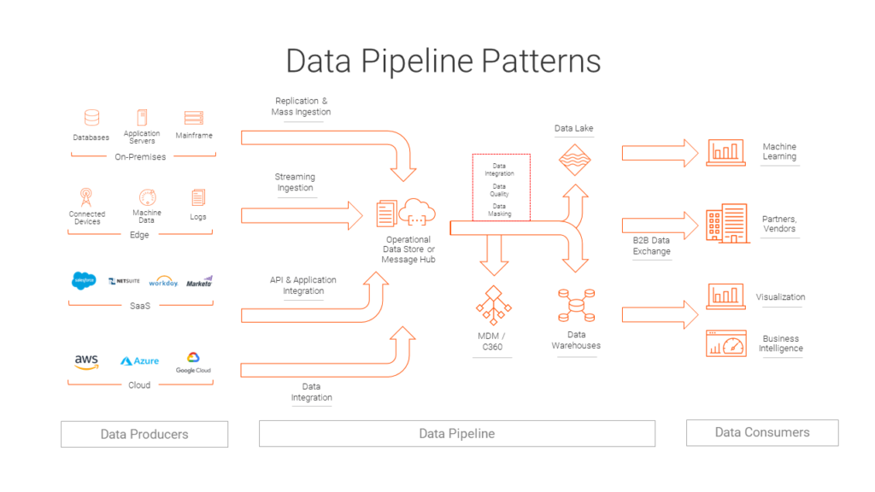
Data Pipeline
For Further Exploration –
Data Engineering Pipeline
The 6 Categories of Data
DB Types
Also , can refer Data (Engineering) slides in the “Software Architecture and Patterns “ Training Session Slides

Slide 3
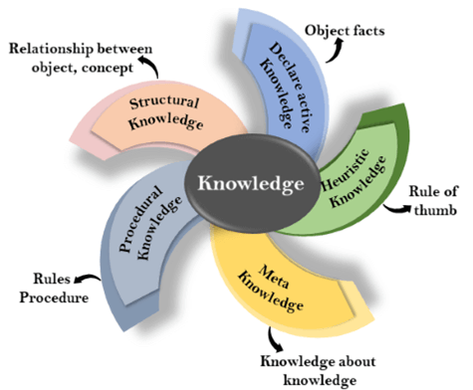
Knowledge Representation
For Further Exploration –
Knowledge Based Agent
A Knowledge Representation Practionary
Data types In Machine Learning

Slide 4
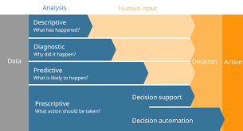
Data Analytics Types
For Further Exploration –
8 Types of Data Analysis
What Is Diagnostic Analytics? How It Works and Examples

Slide 5
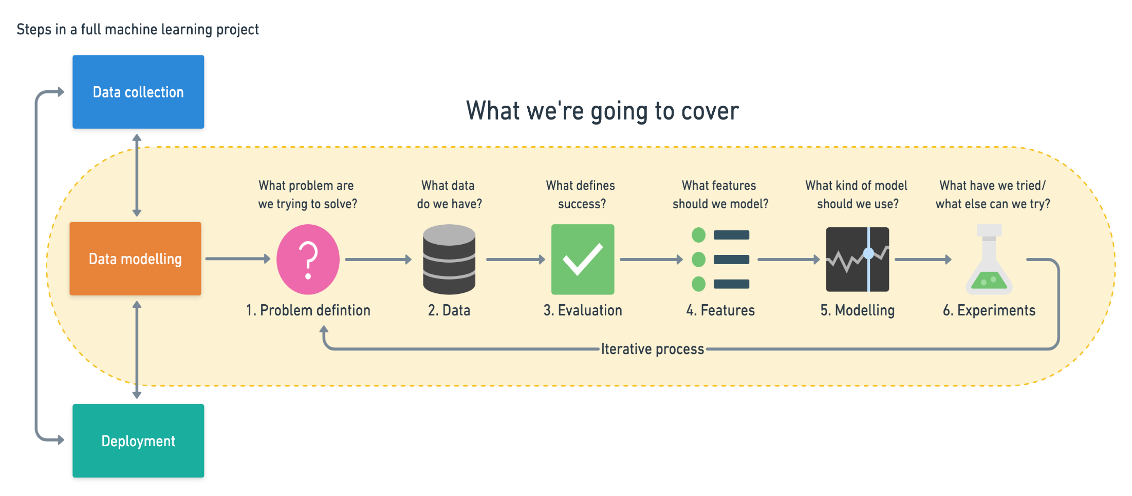
ML Workflow
For Further Exploration –
Introduction to CRISP DM Framework for Data Science and Machine Learning

Slide 6
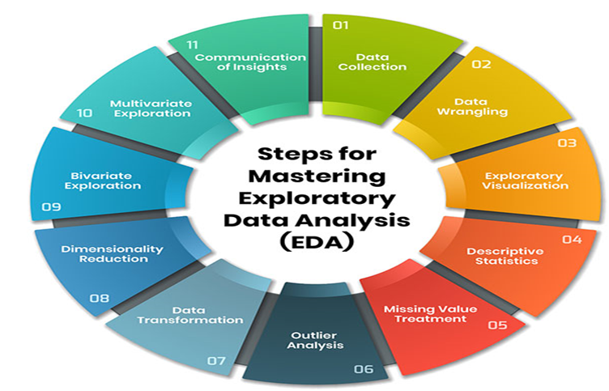
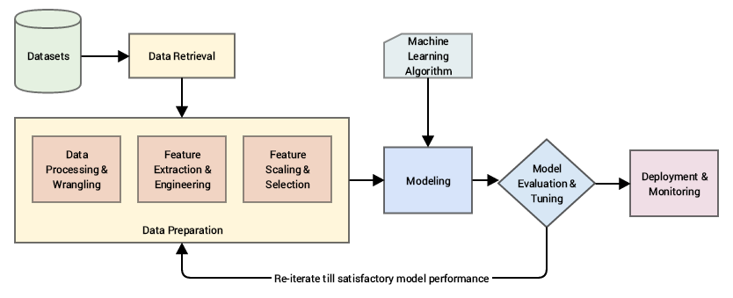
EDA(Exploratory Data Analysis) And Feature Engineering
For Further Exploration –
Data Cleaning In 5 Easy Steps + Examples
A Comprehensive Guide to Mastering Exploratory Data Analysis
How to Handle Big-p, Little-n (p >> n) in Machine Learning - MachineLearningMastery.com
Detecting and Treating Outliers | Treating the odd one out!
Data Leakage in Machine Learning - MachineLearningMastery.com
Data Science from Scratch
Fundamentals of Data Visualization
What is Feature Engineering?
What is Feature Scaling and Why is it Important?
Feature Selection in Machine Learning
Transfer Entropy for Feature Selection
Assumption Selection and Feature Selection
Categorical data: Feature crosses
Python-Feature-Engineering-Cookbook
Feature Engineering for Machine Learning

Slide 7
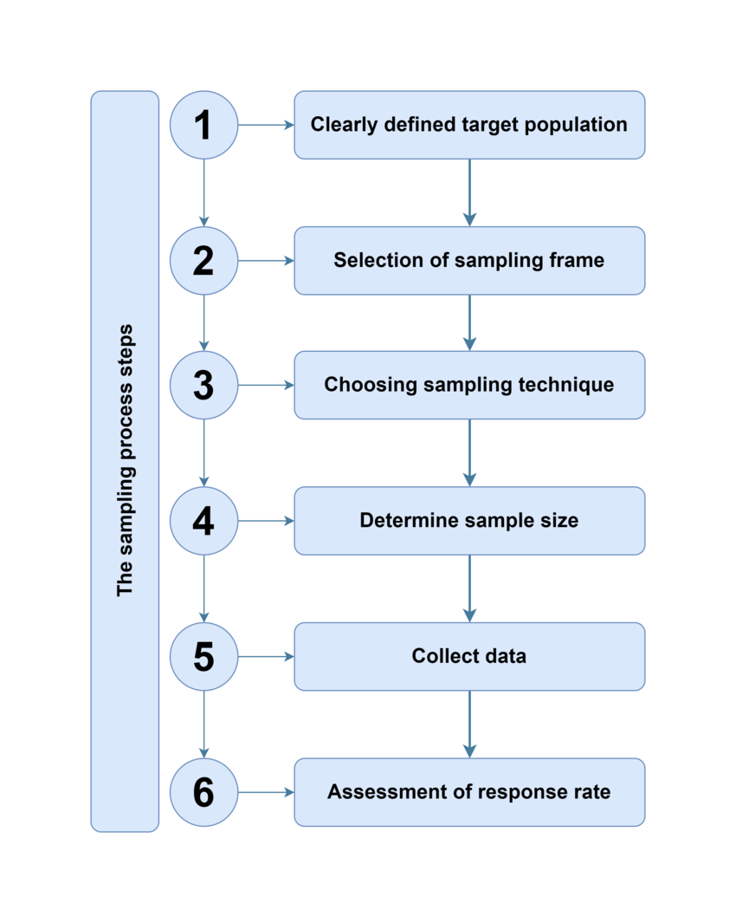
Sampling
For Further Exploration –
About Sampling
Sampling Methods | Types, Techniques & Examples
statistics - Population vs Sampling Frame vs Sample
How does sampling frame and sampling unit influence your sample size calculation?
Statistics and Probability | Khan Academy

Slide 8
Imbalanced Data
In Classification, even after sampling(or even without any sampling) there might be a case of Imbalanced Data(e.g. in a classification task, there can be 3 classes & majority of data pointing to class 1 & a very low minority of data pointing to class2 & class3) & a great cheatsheet on how to handle imbalanced data is available at www.cheatsheets.aqeel-anwar.com. To tackle Imbalanced data, mainly re-sampling training data or loss functions like class-balanced loss(CB Loss: Class-Balanced Loss Based on Effective Number of Samples (Image Classification)) or focal loss(Focal Loss : A better alternative for Cross-Entropy) are used.
Another good article relevant to imbalanced data is Cost-Sensitive Learning for Imbalanced Classification

Slide 9
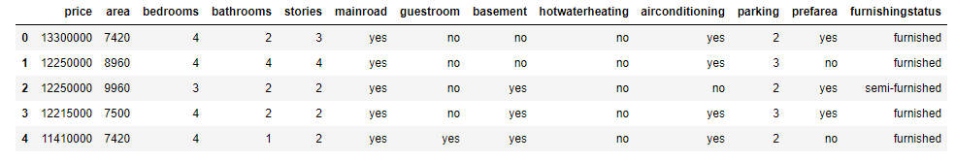

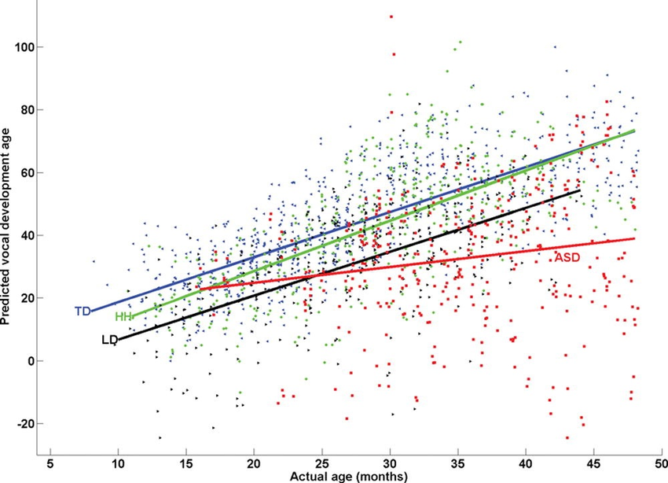
Predictive Analytics Intro Example & y = f(x)
Most AI/ML/DL etc Algorithms’ intent is to find f(x) in “y = f(x)” based on data provided for x(& y). Mainly x & y here are multivariable(i.e. a variable that can contain many values at different times of measurements) i.e. tabular data of samples of x(& y) e.g. as below –
And such f(x) is called parametric model. There are other models also called non-parametric models that will be discussed later.

Slide 10
Maths for AI, ML, DL etc
i) Statistics & Probability - Very helpful for Descriptive Analytics(including EDA[Exploratory Data Analysis] & to some extent DV[Data Visualization]) & can provide non-deterministic/probabilistic values as needed by Linear Algebra data representation below. Also, can be helpful in handling uncertainity, quantifying likelihood, assessing model performance etc. ii) Linear Algebra - Representing (non-)deterministic values in the form of sparse(/dense) vectors/matrices in efficient array or other structures & further (parallel) processing like inferential statistics(for non-deterministic values), proximity measures(e.g. distance or similarity[in general normalized-distance = 1 - normalized-similarity]), matrix factorizations etc to gain insights via proper model development. iii) Multivariable Calculus - mainly used for optimizing the (hyper)parameters of the model or representing the Scientific ML Modelling equations(similar to linear regression).Again here (hyper)parameters can be stochastic as well wherein the values in general are non-deterministic/probabilistic. iv) Topology/Geometry - Topological/Geometric Intuition behind the Probability, Linear Algebra & Calculus above & Image Analysis/Interpretation/Processing in general. By the way, Graph is a special case of Topology. Basically, Graphs have normal nodes & straight edges while Topology has faces(of any shape as well alongwith facial nodes[i.e. nodes having faces], curved edges, metrics i.e. measurements like length, area, volume but lengths and areas are possible in Graphs as well). v) Information Theory – Mainly used to measure Data Quality. To quantify the amount of info(a.k.a entropy) & measure the accuracy, available in the data sources which ultimately leads to better predictive models. Also, can be helpful in good feature selection, decision tree building, cross-entropy loss, Viterbi Algo(commonly used in NLP) & even encoder-decoder modelling which is at the heart of any Transformer implementation which is the backbone of any DL/LLM/GenAI tool.
For Further Exploration –
Some Great Resources to understand the Maths Behind AI
Coding The Matrix
9 Distance Measures in DataScience
Green Tea Press – Free books by Allen B. Downey
Algorithms for Optimization
Bayesian Optimisation
Home page for the book, "Bayesian Data Analysis"
Bayesian Modeling and Computation in Python
Probability Models for Computer Science
An Introduction to Topological Data Analysis

Slide 11
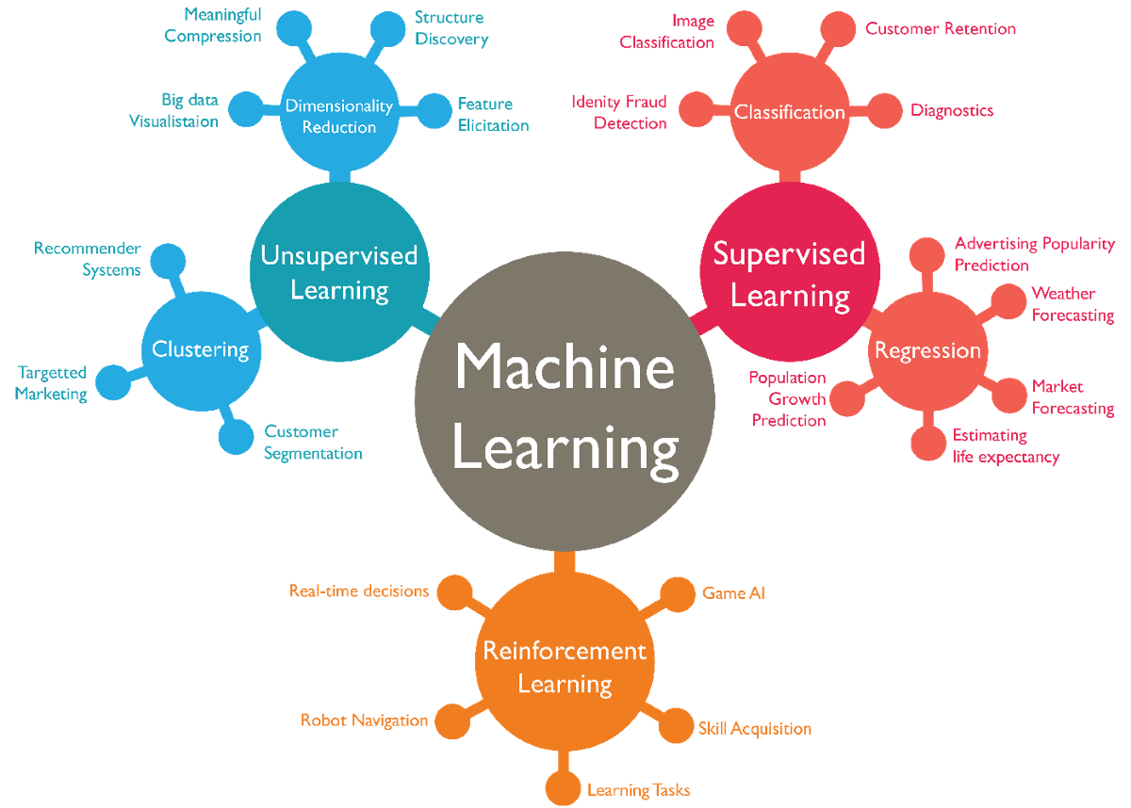
ML Types & Algorithms
N.B. - Some ML algos are based on parametric models while some are based on non-parametric models but most DL algos are based on parametric models
For Further Exploration –
4 Types of Learning in Machine Learning Explained
A Tour of Machine Learning Algorithms
Parametric and Nonparametric Machine Learning Algorithms - MachineLearningMastery.com
What are Parametric Algorithms in Machine Learning??
Algorithm & component reference

Slide 12
Supervised vs Unsupervised vs Semisupervised vs SelfSupervised vs Reinforcement Learning
Supervised Learning – Both x & y are known in general for y = f(x)
Regression - mainly represented by equations e.g. y = ax + b and here y is some numerical value while x can be numerical or categorical data
Classification – mainly represented by inequalities which detects specified regions/classes e.g. if ax+b > m then o/p data belongs to some class1 else class2.here y in general is some categorical data.
Unsupervised Learning – for y = f(x), y is not known but x known
Clustering/Grouping - e.g. doing customer segmentation for marketing/sales Analytics to find groups of customer sales(may be as per regions)
Association Learning - e.g. finding an inference that nappies & baby powder are bought together & so they should ideally be placed nearby in a physical retail store for more sales
Dimensionality Reduction - It’s always advisable to reduce dimensions as much as possible without losing any valuable info, to minimise the “Curse of Dimensionality”.
Semi Supervised Learning – Semi-supervised learning uses a small amount of labeled data alongside a large amount of unlabeled data to train a model.
Self-supervised learning – This is a machine learning paradigm where a model learns from unlabeled data by generating its own supervisory signals. It allows models to learn useful representations from data without relying on human-annotated labels. There is not even a small amount of labeled data like Semi Supervised Learning & all data is unlabeled.
Reinforcement Learning - The purpose of reinforcement learning is for the agent to learn an optimal (or near-optimal) policy that maximizes the reward function or other user-provided reinforcement signal that accumulates from immediate rewards.
N.B. - Some ML algos are based on probabilistic models while some are based on deterministic models but most DL algos are based on probabilistic models. Refer next slide for the same.
For Further Exploration –
Machine Learning Algorithms
Which machine learning algorithm should I use? - The SAS Data Science Blog
Semi-Supervised Learning: Techniques & Examples
Self-Supervised Learning: Definition, Tutorial & Examples
Machine Learning Cheat Sheets
Machine-Learning-Algorithms
Mastering-Machine-Learning-Algorithms
HandsOn-Unsupervised-Learning-with-Python
Hands-on Unsupervised Learning Using Python

Slide 13
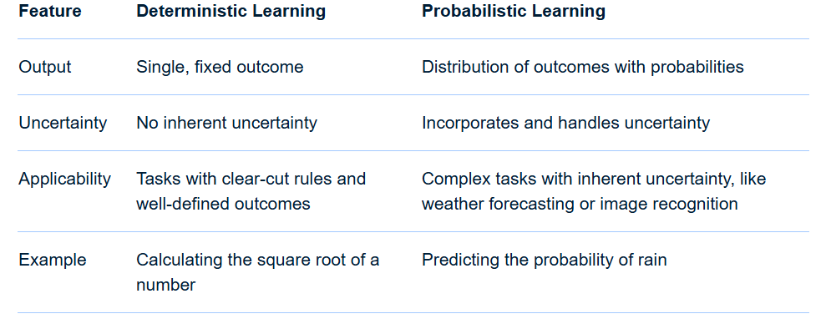
Deterministic vs Probabilistic Learning
In essence: Deterministic learning provides a clear and precise answer, while probabilistic learning offers a range of possibilities and their likelihoods, allowing for a more nuanced understanding of uncertain situations.
For Further Exploration –
Probabilistic vs. Deterministic Models in AI/ML: A Detailed Explanation
What is Deterministic/Probabilistic Data? | Definition from TechTarget
Probabilistic and Deterministic Results in AI Systems - Gaine Technology
What is the difference between deterministic and stochastic models?
Deterministic vs Stochastic - Machine Learning Fundamentals

Slide 14
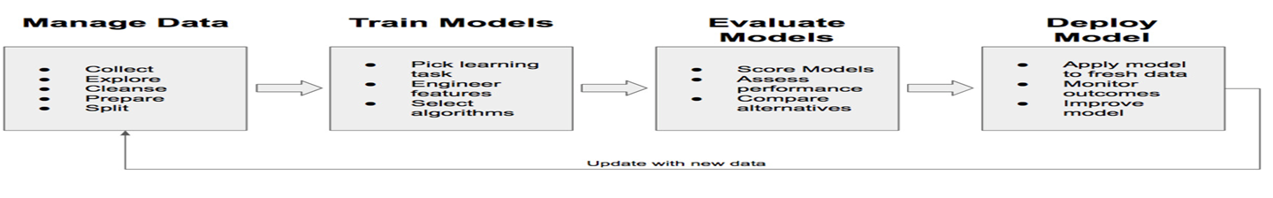
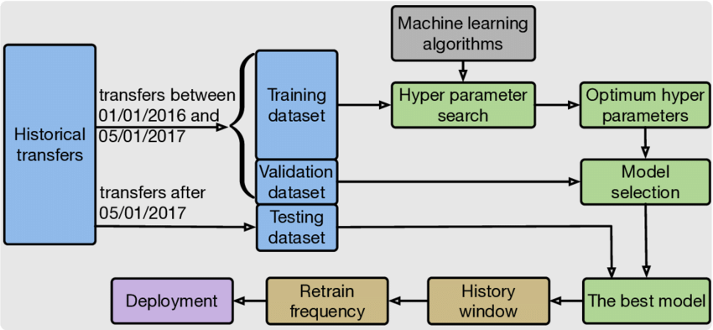
ML Modelling Workflow

Slide 15
ML Modelling Workflow (Steps)
Data Seggregation - The input data needs to be segregated into –
i) Training set - say 60%..this is the data that we will train our model(say to fit the model to the data i.e. to find the function f)
ii) Validation set - say 20%. this is needed to validate how good is our model & used in the Evaluation phase. Above segregation can be done based on 60-20(or some other % based distribution) rule or something as complex as k-fold Cross-Validation
iii) Test set - say 20%. This is needed to provide an unbiased evaluation of a final model to fit on the training dataset.
For more details refer What is the Difference Between Test and Validation Datasets & Time based splitting and determining if Train & Test data come from the same distribution

Slide 16
ML Modelling Workflow (Steps)
Model Selection & Training - Do the training on the training set to fit/find the model. Here a decision you have to take is to use classical ML or DL algos. General thumb rule in general is to use classical ML algos for structured/tabular data(except time-series data & graph data) & to use DL techniques for unstructured data(text, speech, music, images, videos etc), time-series data & graph data. Also, in case of classical ML algos, understanding of tree based models(number of tress & levels within the trees etc) is crucial too. An important concept related to training is Cost/Loss function(which needs to be converged so that the error <= threshold value & thereby we will get the optimal parameter values) & for that, can refer –
i)Cost/Loss function – Loss function – Wikipedia, How are the cost functions for Neural Networks derived & Difference Between the Cost, Loss, and the Objective Function
ii) Different types of Cost/Loss functions used in classic ml & neural nets - A Simple Understanding of the ML Landscape with Various Cost Functions!, The Role of Cost Functions in Machine Learning: Types, Significance, and Impact on Model Performance, What is Cost Function in Machine Learning & A list of cost functions used in neural networks, alongside applications

Slide 17
ML Modelling Workflow (Steps)
iii) Cost/Loss functions available in Keras & Pytorch – Keras Loss Functions: Everything You Need to Know & PyTorch Loss Functions: The Ultimate Guide
Another important concept is to use some Optimisation technique(s) to optimise the cost function (e.g. to minimise the loss) . Generally, for deterministic & stochastic/probabilistic data we use different techniques as depicted in Essential-Math-For-AI. Although in this depiction it shows that for probabilistic data, MLE & joint probability distribution should be used but that’s actually the case for independent events as mentioned in Calculate Maximum Likelihood Estimator with Newton-Raphson Method using R. For dependent events, we should use Bayesian Inference(bayesian_inference_basic_tutorial.pdf). Another relevant article is MLE, MAP and Bayesian Inference. Similar logic can be extended to deterministic/probabilistic Embeddings. Embeddings will be discussed later. Now the aforementioned optimisation techniques are to estimate optimal values of parameters of the function(& not hyper-parameters - a concept explained later).
A good starting point for various Optimisation techniques are - Understanding Optimization Algorithms in Machine Learning, Optimization Essentials for Machine Learning & 6 Continuous Optimisation with Iterative Algorithms
Also , training can be done in a distributed way via data or model parallelism & for that refer Understanding Data Parallelism in Machine Learning | Telesens & Introduction to Model Parallelism - Amazon SageMaker AI

Slide 18
ML Modelling Workflow (Steps)
Evaluation - We calculate various evaluation metrics(based on which we decide how good our model is) for various ML algos using the validation set data e.g . for regression we generally use Evaluation Metrics for Your Regression Model while for classification we can use Classification Evaluation Metrics. For the majority of most important metrics, refer How to Evaluate Clustering Algorithms?, Performance Metrics in Machine Learning & Fundamentals of Machine Learning Model Evaluation
Similarly , there are different evaluation metrics for time-series data, graph data, nlp, cv etc
A concept related to Metrics Evaluation is Sensitivity vs Specificity & for that one can refer Sensitivity and specificity
Model experimentation(Retraining[if needed]) - if we are not satisfied with the evaluation metrics, we can try any/some/all the following –
a) cleaning the data more in some other ways or re-sampling or trying other different ways of feature engineering
b) using some different ML algo
c) changing the cost function or parameter optimiser or both
d) Regularisation - if your model works great with the training data but works very poorly with actual/test data that means the data is over-fitted & to overcome overfitting, we use various regularisation techniques e.g. in regression we can use lasso(L1)/ridge(L2)[L2 vs L1 Regularization in Machine Learning & Everything you wanted to know about Lasso & Ridge Regression] while in DL networks we can use Dropout(& other) technique(s).

Slide 19
ML Modelling Workflow (Steps)
Related to overfitting is the concept of “bias vs variance” which is well explained at Machine Learning Fundamentals: Bias and Variance.
Some other good relevant articles are Regularization (mathematics) - Wikipedia , Intuitive Understanding of Bias and Variance Trade-Off, How To Address Bias-Variance Tradeoff in Machine Learning & 5 ways to achieve right balance of Bias and Variance in ML model
For more in-depth details, refer The-Regularization-Cookbook
HyperParameter tuning - Any ML process can be defined as ML = (Representation) + Objective/Training function + Optimisation(e.g. minimise some loss function or converge a function or find the MLE of some joint Probability Distribution) . As of now, just keep in mind that Representation is needed only for unstructured data(& not needed for structured/tabular data) & we need to do optimisation in any ML algo for any data(structured/unstructured) & while doing that we use some parameters called HyperParameters(e.g. epoch size, batch size, learning rate etc). The difference between parameters & hyper-parameters is that parameters are kind of outputs we want to find out to define the model properly while hyper-parameters are configurable input parameters that we use as part of the optimisation process. For hyper-parameter optimisation(i.e. finding optimal values of hyper-parameters) we can use Grid Search(human intervention required)/Randomised Search(fully automated) techniques.Also Bayesian inference techniques is sometimes used for hyper-parameter tuning. Some good relevant articles are - Difference Between a Batch and an Epoch in a Neural Network & How to Configure the Learning Rate When Training Deep Learning Neural Networks

Slide 20
ML Modelling Workflow (Steps)
For a somewhat detailed account of most of the optimisation techniques used(for parameters/hyper-parameters), refer ML Optimization Methods and Techniques. A related topic is ML Model Convergence & for that refer A Gentle Introduction to Premature Convergence.
For more in-depth details on Hyperparameter Tuning, refer Hyperparameter-Tuning-with-Python
Prediction - if we are satisfied with the evaluation metrics then predict the outcome on your test(& actual) data.
One can also refer the articles that are tagged as ML/Machine Learning Lesson available at https://medium.com/@nerdjock
For Further Exploration -
Steps in Machine Learning: A Comprehensive Guide
4 Stages of the Machine Learning (ML) Modeling Cycle
About-loss-and-loss-functions
The-Little-Book-of-ML-Metrics
Calibration of Machine Learning Models
How to select a machine learning algorithm - Azure Machine Learning | Microsoft Learn
Machine Learning Algorithm Cheat Sheet
Hands-On-Simulation-Modeling-with-Python
PracticalSimulations
Instance-based vs Model-based Learning

Slide 21
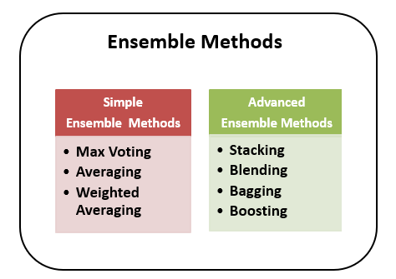
Ensemble Learning
For Further Exploration –
Ensemble Methods in Machine Learning - Prwatech
Ensemble Learning Algorithms Cheatsheet
ensemble-methods-notebooks
Ensemble-Machine-Learning-Cookbook
Hands-On-Ensemble-Learning-with-Python

Slide 22
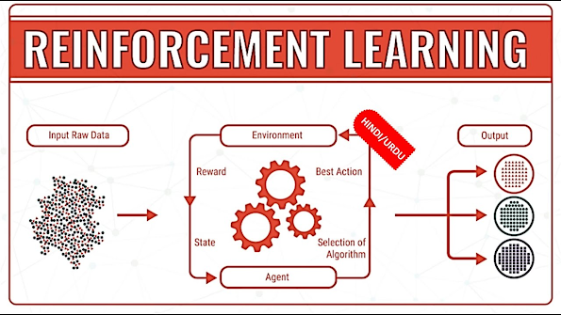
Reinforcement Learning
For Further Exploration –
Reinforcement Learning, Intuition, and Abductive Reasoning
Algorithms for Decision Making
Some Good RL Resources – I
Some Good RL Resources - II

Slide 23
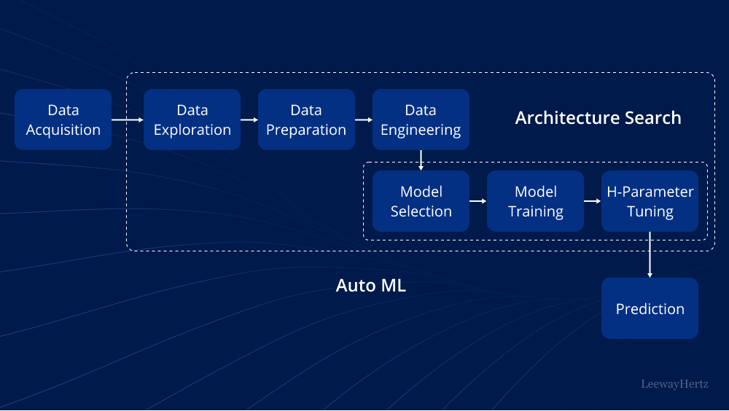
AutoML(Search for Best ML/DL Architecture)
For Further Exploration –
AutoML: Components, techniques, working, tools, platforms and use cases
Awesome-AutoML
Awesome-AutoML-Books

Slide 24
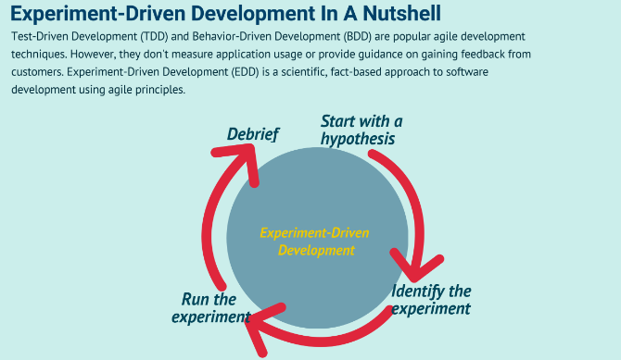
Experiment Driven Development(using A/B [Statistical] Testing)
Feature Flags(based frameworks) can be useful for A/B Testing.
For Further Exploration-
Experiment-Driven Development In A Nutshell
Experimentation-driven development
Experiment Driven Development
How to apply hypothesis-driven development
Data-driven hypothesis development
Micro-Experiments and Experiment Driven Development
A/B Testing Simplified: Steps to Data-Driven Decisions
A/B testing - Wikipedia
15 Math Concepts Every Data Scientist Should Know (Check especially Chapters 2 & 7 for A/B Testing)
A/B Testing Statistics: An Intuitive Guide For Non-Mathematicians
A/B Testing: A Complete Guide to Statistical Testing
A/B Testing Statistics Made Simple
Statistical Significance in A/B Testing
A-B-Testing
The ultimate guide to A/B testing
Experimentation for Engineers: From A/B Testing to Bayesian Optimization
A Summary of Udacity A/B Testing Course
Experiment-Driven Development: A/B Testing and Beyond with AI

Slide 25
Further References
Practical Machine Learning with Python
Artificial Intelligence: A Modern Approach, 4th US ed.
Hands-On Machine Learning with Scikit-Learn, Keras, and TensorFlow: Concepts, Tools, and Techniques
Trevor Hastie’s Books
valeman/awesome-conformal-prediction
Speech and Language Processing
Representation Learning for Natural Language Processing
Transfer Learning vs Fine Tuning LLMs: Differences
awesome-llm-books
awesome-vector-database
awesome-graph-universe
Computer Vision and Deep Learning Courses - CVDL Master
Generative models vs Discriminative models for Deep Learning.
Decoding Generative and Discriminative Models
Generative Deep Learning: Teaching Machines To Paint, Write, Compose, and Play
The Theory and Practice of Enterprise AI
Agentic Artificial Intelligence
Compendium-of-free-ML-reading-resources
V7 Blog
Covariance vs. Correlation: Differences to Know
Introduction to the Correlation Matrix
Analysis of covariance
Intuition Behind Kernels in Machine Learning
What is Classification Threshold
Ridhima Kumar – Medium
Venkat Raman | LinkedIn

Slide 26
Thank You

